Slide 1
Pyramid Automation Prosperity Through Technology
Surge Protection Devices

Slide 2
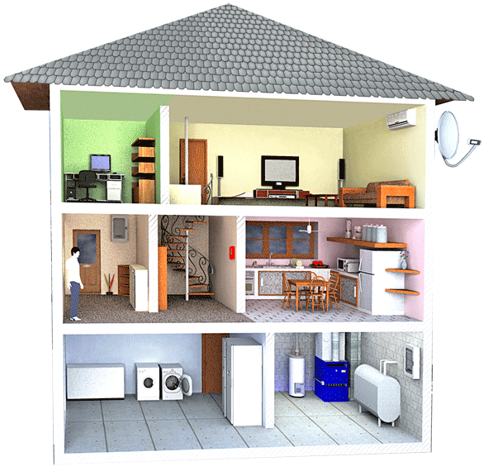
Risk Overview
More than 75% of all overvoltage problems are caused within a facility from equipment.
About 25% Issues are due to external Issues, i.e. Lightening and Faults in Transmission Lines.

Slide 3
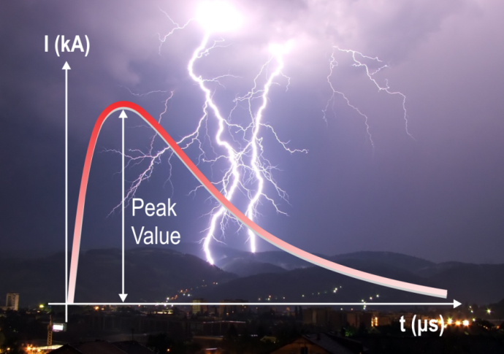
Overvoltage Types
Surges: high amplitude, short duration overvoltage
- They cause damage to the equipment
Temporary over voltages (TOVs): low amplitude, long duration
- They cause damage to the SPD device

Slide 4
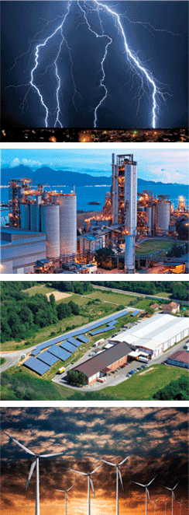
Causes of Surges / Transients
Lightning – it is powerful, but seldom
Power Switching – Becoming more and more frequent
Load Switching – Utillities & customer
(motors, large loads, faults, fuse operation)
Source Switching
(smart grid, Gensets, PV, WT)
Electrostatics – Pulses with narrow and high amplitudes
Internally generated ≈ 75 %, Externaly generated ≈ 25 %

Slide 5
Causes of TOVs
They are present in the power supply networks due to different reasons:
faults between high-voltage systems and earth,
faults in the low-voltage distribution supply system,
capacitor switching and motor stopping and starting,
insulation faults or loss of a supply conductor,
short circuit between line conductor and neutral conductor.
Long duration (up to 5s according the standard)
The main reason for SPD damage

Slide 6
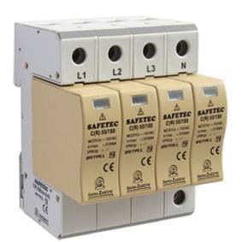
SAFETEC TCG Technology

Slide 7
SAFETEC Technology
KEY ADVANTAGES OF SAFETEC TECHNOLOGY:
CONTROLLED DISCONNECTON - HIGH RELIABILITY!
ARC PREVENTION SOLUTION – NO RISK OF FIRE IN PV!
TOV IMMUNITY – LONGER LIFE OF SPD
NO BACKUP FUSE NEEDED – LOWER COST!
„LEAKAGE CURRENT FREE“ OPTION
OVERLOAD FUNCTION - SAFER PRODUCT!

Slide 8
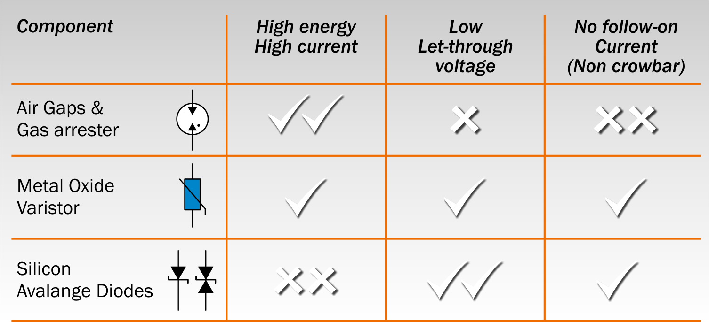
Components of SPDs

Slide 9
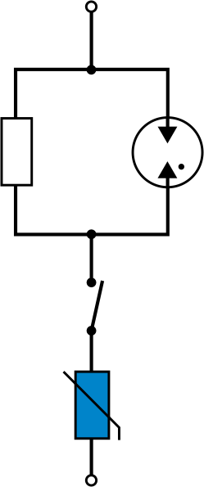
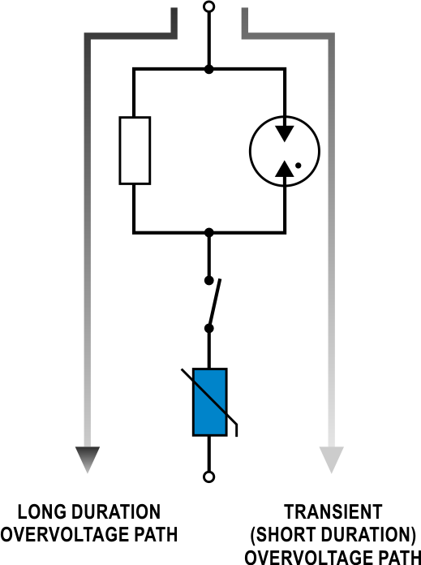
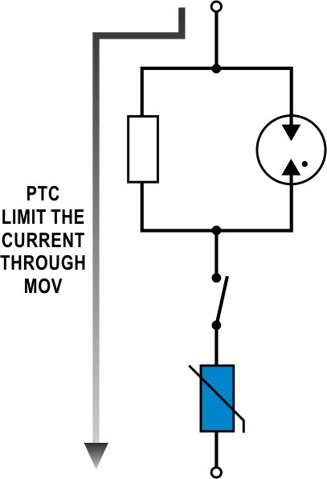
Working Concept of SAFETEC Technology
NORMAL CONDITION
TWO POSSIBLE
REACTIONS
IN CASE OF LONG
DURATION OVERVOLTAGES
MOV
GDT
CURRENT LIMITER
THERMAL
DISCONNECTOR

Slide 10
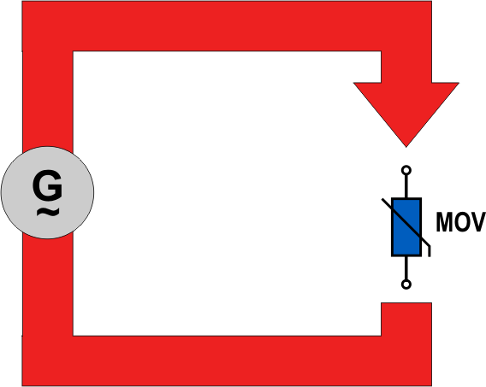
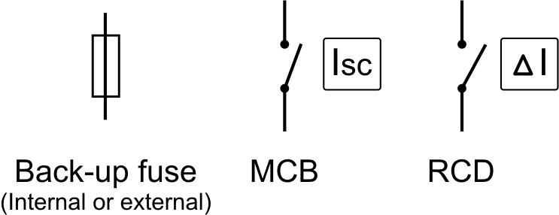
Other Brands Technology
BASED ON SHORT CIRCUIT TECHNOLOGY:
Iscc
Protection in case of MOV failure

Slide 11
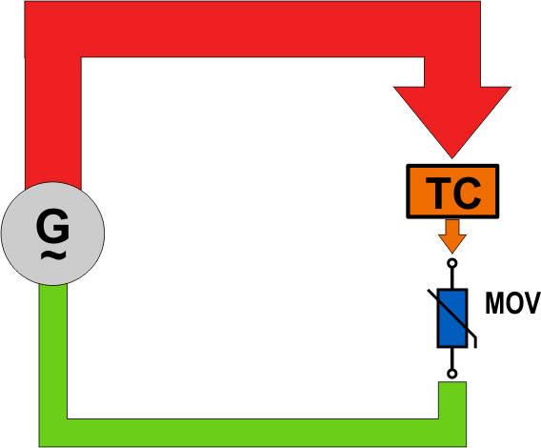
TC TECHNOLOGY ACTIVATION
limits the Iscc

Slide 12
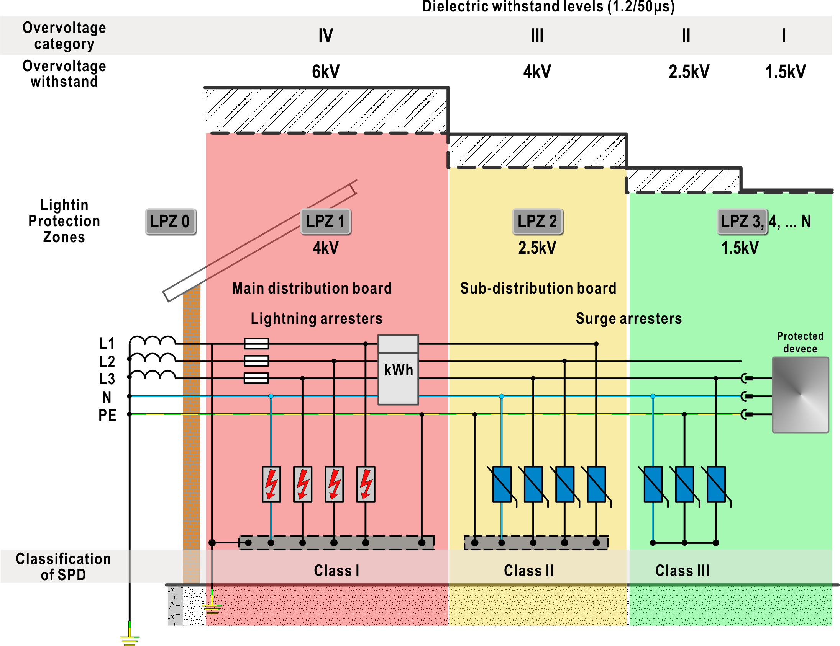
Surge protection according to IEC standards

Slide 13
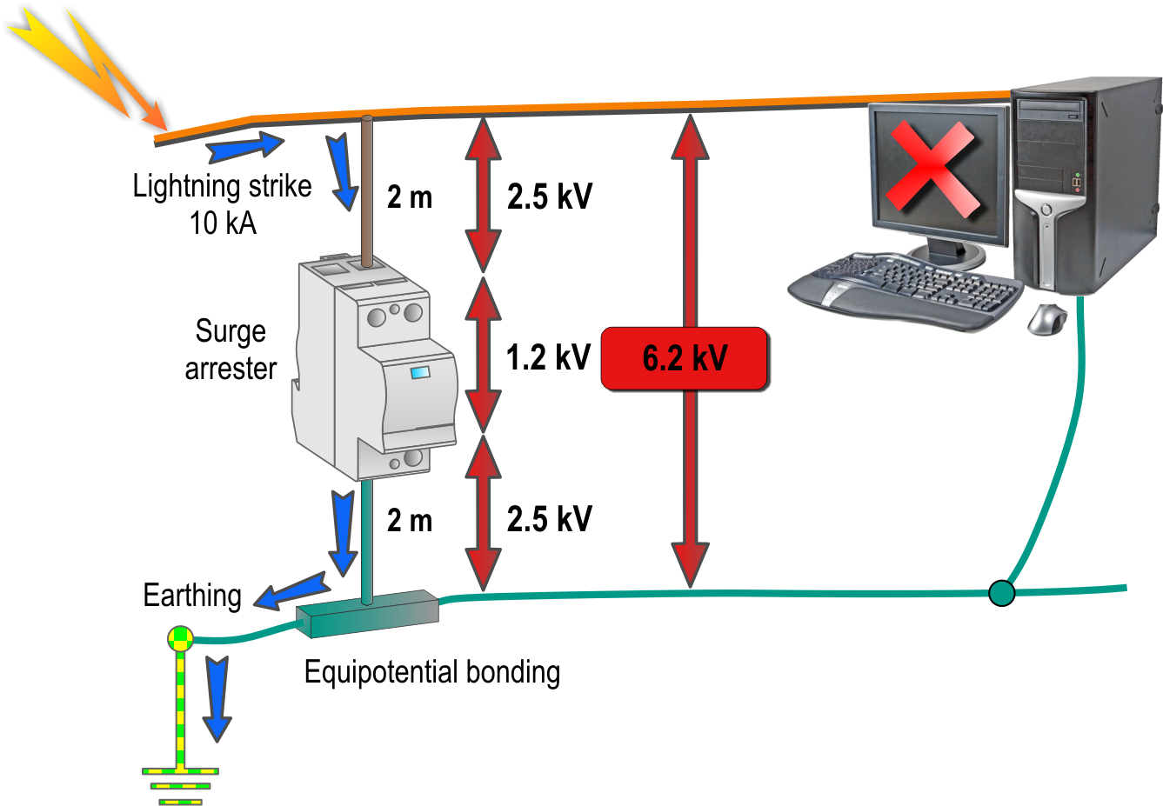
EFFECTIVE OVERVOLTAGE PROTECTION
AN EXAMPLE OF INCORRECT MOUNTING OF SURGE ARRESTER

Slide 14
Benefits
Comparison | ISKRA TCG Technology | ABB, Phoenix, DHEN, LEUTRON (Solutions in the Market)
TOV Immunity | 100% | Not Available
Disconnection | Controlled Disconnection with physical barrier | Unreliable Disconnection
ARC | Cutting & Limiting ARC Current | Not Available
Leakage Current | No Leakage Current | Partial Solution
Back-up Fuse | Not Needed | Partial Solution
Overload Function | YES | Not Available
Thermal Runaway | No Possibility | High Risk
Protection Against Ageing | YES | Partial Solution
Galvanic Separation of MOV | YES | Not Available
GDT – Gas Discharge Tube | YES (Tube with special gases) | Spark Gap

Slide 15
CONCLUSION
Does an investment into surge protection pay off?
Surge protection prevents from:
Loss of communication connections,
Data loss,
Blackout of supply network,
Complaints of unsatisfied customers,
Breakdown or damages of devices,
Turnover loss
Stopped production process.

